Slide 1
Predicting the likelihood of E-signing based on financial history
Project Members :
Arnav Jyoti Nath
Gopanjal Nath
Bishal Kr. Taye
Subham kumar singh
Harsh rajput
Krishnendu Das

Slide 2

Acknowledgements
Special thanks to Md Farmanul Haque Sir, Aspirevision tech, for his support, collaboration, and guidance for the completion of this project.

Slide 3
Cliff Notes on Machine Learning
Purely human judgement comes with its own set of biases and errors
Big data is long (multiple rows) and/or wide (lots of columns)
Machine learning is a branch of statistics designed for big data
Focus is on prediction rather than causality
Common application is to make predictions
Forecasting customer turn-over
Predict loan applicant default

Slide 4
Cliff Notes on Machine Learning (cont.)
Feature extraction
Process for figuring out what independent variables (“features”) the predictive models should use
Keep useful features and discard less useful features
Cluster analysis, consult experts, etc.
Regularization
Coming up with the least complex model that generalizes well
Include important features & minimize effects of less important features
Avoid overfitting the data
Cross-validation
Test prediction accuracy
Training data set
Test data set (data held back to test model accuracy)

Slide 5
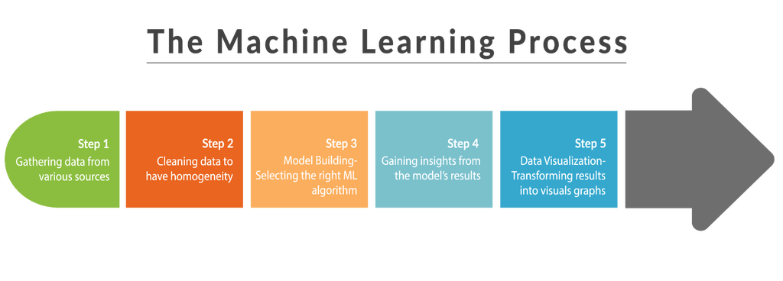
Research Idea: Machine Learning to Predict Project Outcomes
Use machine learning to create predictive models to:
Identify key software quality and project attributes to control and improve
Predict software project success, cost, and duration
Provide decision makers with additional data to make software project investment decisions
Identify attributes and quantify their impact on project outcomes
Prediction accuracy improves with growing corpus of software project attribute data

Slide 6
Steps of Machine Learning
Importing Libraries – numpy, pandas, sklearn, etc.
Importing Data.
Identifying the Independent and Dependant variables
Data Cleaning
Train and Test split.
Model Building
Checking Accuracy
Visualization
Optimization

Slide 7
Libraries Imported
Pandas : For data retrieval, manipulation, storage and analysis.
numpy : Adds support for large, multidimensional arrays and matrices, along with a large collection of high-level mathematical functions.
Matplotlib: Provides an object-oriented API for embedding plots into applications.
Seaborn: Data visualization library based on matplotlib, used for statistical data.
Time : Provides various time-related functions
Random : pick random elements within a uniform range
Sklearn : the library that holds the algorithm of machine learning

Slide 8
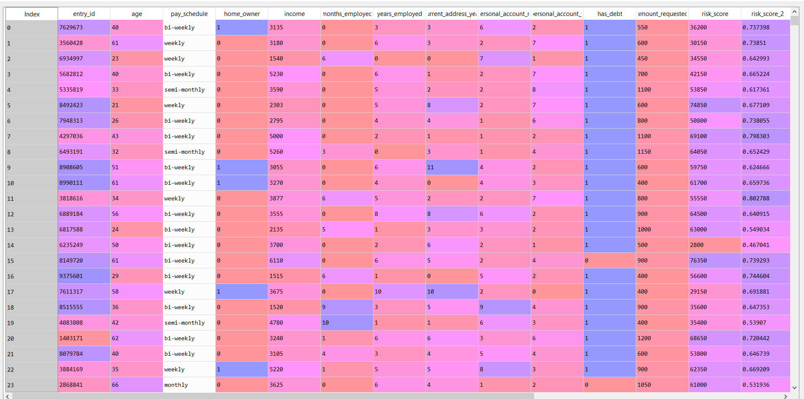
Dataset used

Slide 9
Data Cleaning
EDA
dataset.isna().any() :
Both the isna and na return all the attributes that has nan just to make the data better it is also termed as data housekeeping
Before plotting the histograms we need to make sure that all the categorical values are removed and all the missing values or NAN should be removed
In this case the pay_schedule is a categorical value.
While building the model
dataset = dataset.drop(columns = ['months_employed'])
dataset['personal_account_months'] = (dataset.personal_account_m + (dataset.personal_account_y * 12))
- this combines the months and years into a single column that is in the form of months
dataset[['personal_account_m', 'personal_account_y', 'personal_account_months']].head()
dataset = dataset.drop(columns = ['personal_account_m', 'personal_account_y'])
(getting rid of the original column)

Slide 10
Data Cleaning
We use the function get_dummies(dataset)
to find all the categoriacl columns and create their dummies.
To avoid the dummy variable trap remove one of the dummy column
dataset = dataset.drop(columns = ['pay_schedule_semi-monthly'])
Removing extra columns :
Those columns which are important but are not required in the trainig set. In this case these columns are e_signed and entry_id
response = dataset["e_signed"]
users = dataset['entry_id']
dataset = dataset.drop(columns = ["e_signed", "entry_id"])

Slide 11
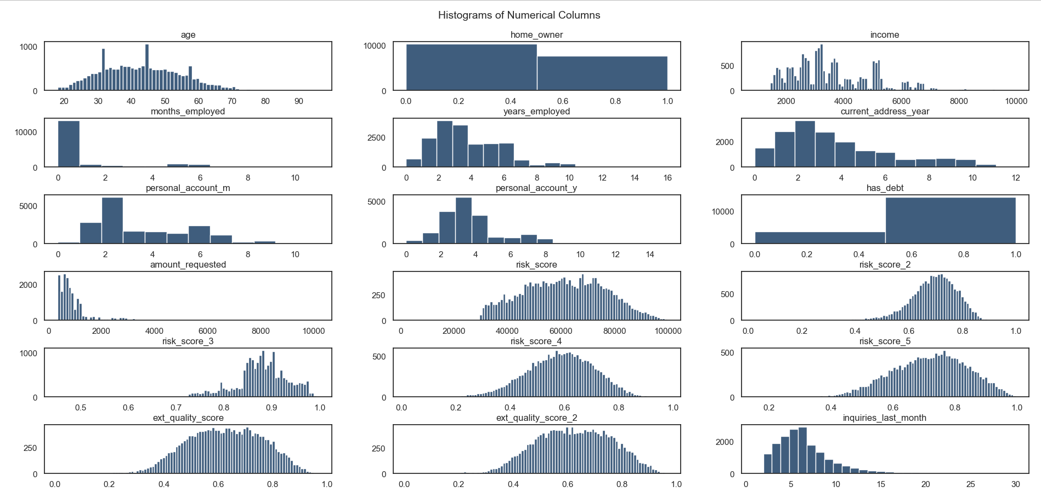
Analysis of Data
We create the bar graph. The vals variable holds all the unique values of the column and also helps tp scale the graph.

Slide 12
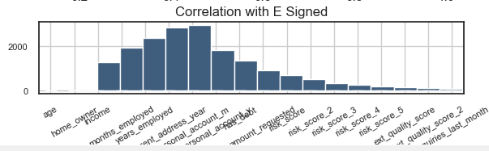
Data Analysis II
This Shows the correlation of all the attributes with the dependant variable e_signed

Slide 13
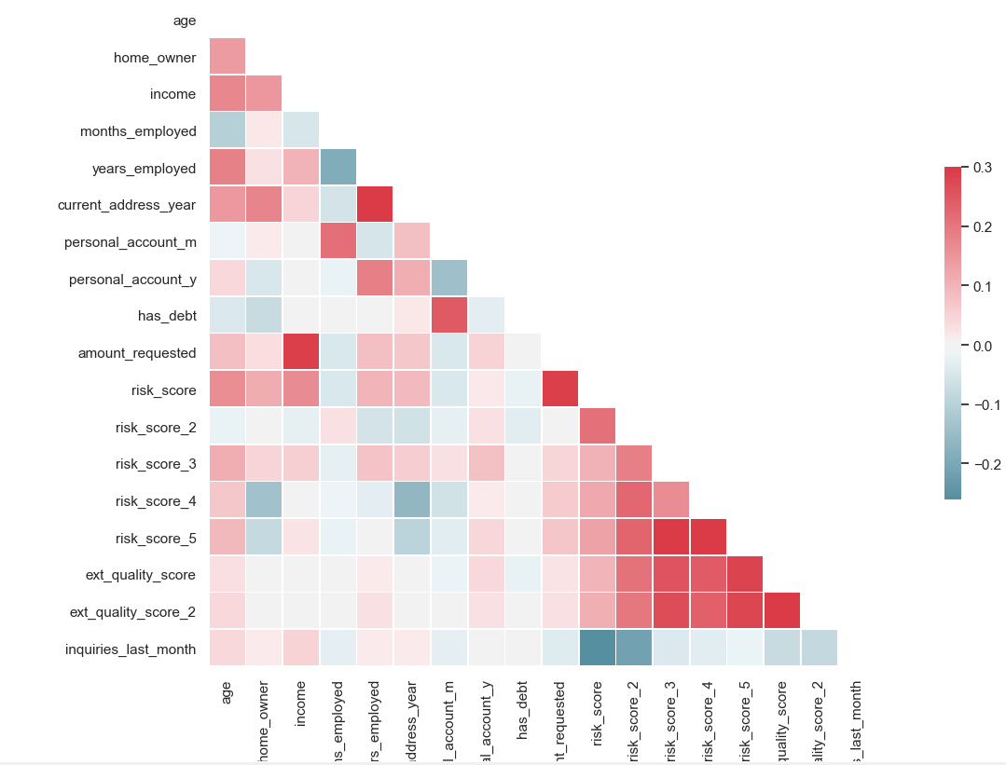
Representing Correlation:
Finally, a heat map is produced of all the features, so that the correlation of each feature to every other feature through the entire data set is represented in a single visual representation. We mask the upper half of the heat map as it is redundant due to being a mirror of the lower half. We do not include entry_ID and whether or not user has e-signed or not, as user ID is not an affecting feature and the e-signed is the dependant variable.

Slide 14
Model Building
We divide our data set on 8:2 ratio (80% train, 20% test) where our X (independent variable) constitutes of a feature matrix of all features (excepted-signed status), and Y (dependent variable) will have e-signed status only in a vector.
Feature scaling is performed on the training and test sets of X, and we use Data Frame to ensure that our automatically imposed index column is stored safely so we can link the data.

Slide 15
Model Building
To find the best model for our data set, we will fit it to multiple different classification models and check the accuracy, precision, recall and f1 score for each of those models until we find the best model (using the appropriate score functions for each of them). The following models were used in this project:
1. Logistic Regression
2. SVC (Linear Kernel)
3. SVC (RBF Kernel)
4. Decision Tree
5. Random Forest

Slide 16
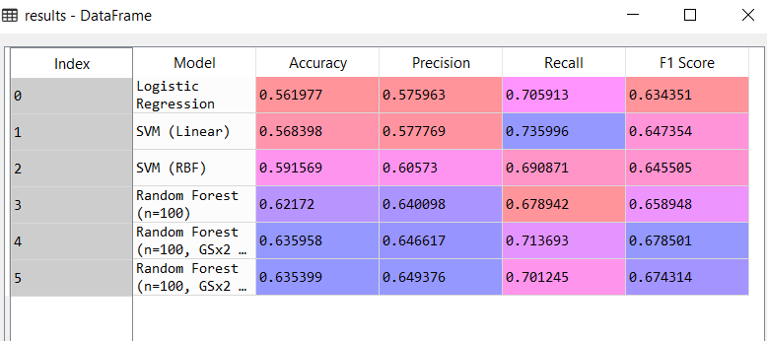
Model Building
We have found that Random Forest gives the best accuracy, so we use K-fold cross validation and 2 rounds of Grid Search (entropy criterion) to further optimize our predictions from Random Forest. K-Folds Cross Validation is a method of training a model by dividing the data set into n number of folds, or divisions. Now, the training of the data is done on (n-1) of those divisions with the n th division being used for testing. This enhances the accuracy, Grid Search is an exhaustive search through each and every value for a given estimator. This also enhances the accuracy of the model. We store the scores of each fit to obtain the final output:

Slide 17
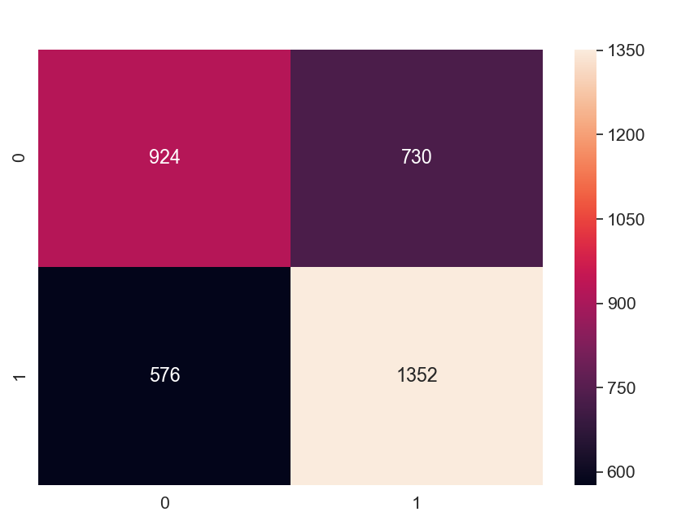
The Confusing Matrix
Now that we have finally obtained our best model and optimized it as well, we can represent the exact predictions and their correctness through a Confusion Matrix
This is the output confusion matrix we have obtained from our predictions, where we have 924 true positive predictions, 730 false positive predictions, 576 false negative predictions, 1352 true negative predictions.

Slide 18
Conclusion
After testing accuracy of multiple models, namely - Logistic Regression, SVM, Decision Tree and Random Forest and calculating their prediction accuracy, we have found that Random Forest provides the best accuracy (around 62%) which we have further optimized through Grid Search to obtain a final accuracy of 64.00%(approx), which shows our algorithm is quite accurate, especially considering we are working with 17,000+ entities. It has provided us with an indication of which of these 17,000 users are likely to e-sign. We have purposefully left some attributes by dropping them as the aim is to distinctly single out those customers who are likely to e-sign so the company may engage with them again and rekindle their interest in the service. In conclusion, we have obtained an accurate model (Random Forest) and predicted possible customers’ e-signed out at 64.00% accuracy so that churn-rate can be effectively minimized by the company.

Slide 19
Biography
References Used:
1. Basics of Python: https://www.w3schools.com/python/python_reference.aspϖ
2. Python Libraries: https://numpy.org/ϖ https://pandas.pydata.org/ϖ https://matplotlib.org/3.1.1/tutorials/introductory/pyplot.htmlϖ
3. Sci-Kit Learn: https://scikit-learn.org/stable/getting_started.htmlϖ
4. Seaborn: https://seaborn.pydata.org/introduction.htmlϖ

